Slide 1

YEAR 5
Welcome to Pine Class

Slide 2
Meet the Year Five Team
Mrs Tucker (Tue, Wed, Thur)
Mr Smith (Mon, Fri)
Ms Taylor
Mrs Blackmore
Ms Oldham
Mrs Maskell

Slide 3
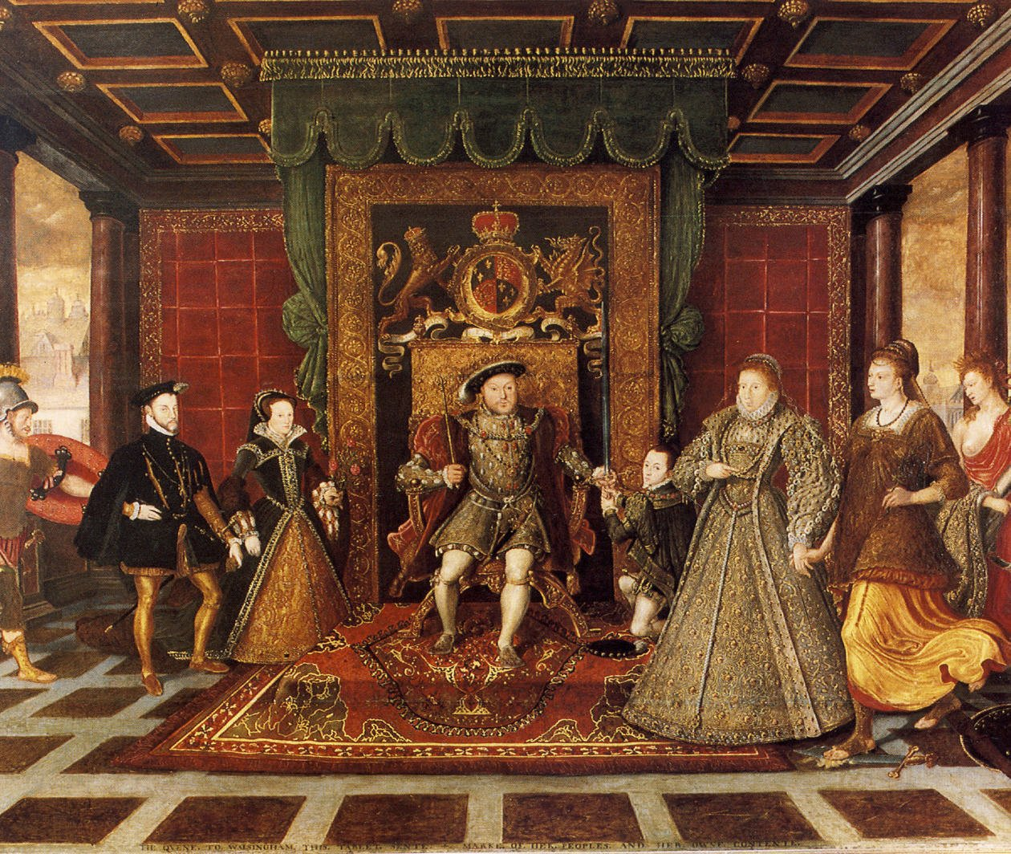


Year 5 Topics
Autumn: Tenacious Tudors
Spring: Ruthless Rivers
Summer: Spectacular Space

Slide 4


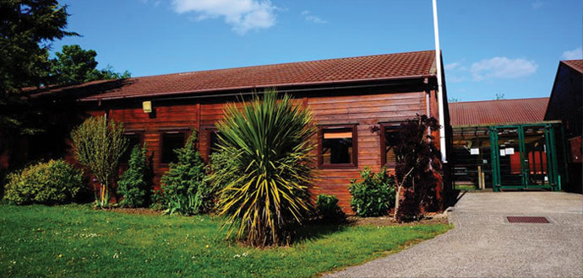
Year 5 potential trips
Autumn
Whole-school pantomime
Spring
River Thames and
Greenwich park
Summer
Environmental Science residential
The Lincolnsfield centre
Approximate cost of year: £150

Slide 5
Uniform
Please make sure your child has the correct school uniform including plain black shoes (no sandals or open-toed shoes/no heels or trainers).
Keep long hair tied back while children are at school because it can obstruct their vision and distract them when they are learning.
Please keep hair accessories to a minimum – e.g. navy blue hair bobble/scrunchie, small hair slide to keep hair out of the eyes.
Ensure that your child has a warm/waterproof winter coat for the cold weather as well as hats, gloves and scarves. Label everything!
Does your child wear glasses? Make sure they have them and let me know so I can make sure they are being worn.

Slide 6
P.E
Please ensure that your child arrives at school on their P.E. days wearing the correct P.E. kit. Your child will remain in their P.E kit throughout the day to reduce the amount of items brought into school.
Indoor:-
Black/ Navy shorts
Plain white T-shirt/white polo shirt
Black Plimsolls/trainers
Outdoor:-
Navy jogging bottoms
Plain white T-shirt/white polo shirt
Navy sweatshirt/hoodie
trainers
No earrings are allowed to be worn during any P.E. lessons. Please send your child in without earrings on P.E. days.
PE Days
Wednesday and Friday
Swimming
Next half-term, information to follow

Slide 7

Reading
All children will be assessed for reading within the first few weeks, checking both their phase and book band.
Children will be reading daily in school and will keep the same book all week. This will be changed on a Monday.
Children will have the opportunity to bring home a ‘sharing’ book. This works the same way as a library book and is chosen by the children based on their interests. This is in addition to their reading book.

Slide 8
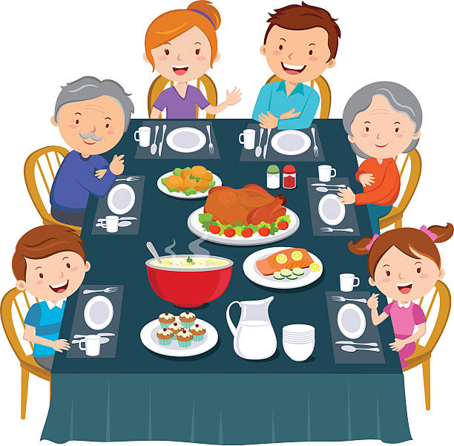
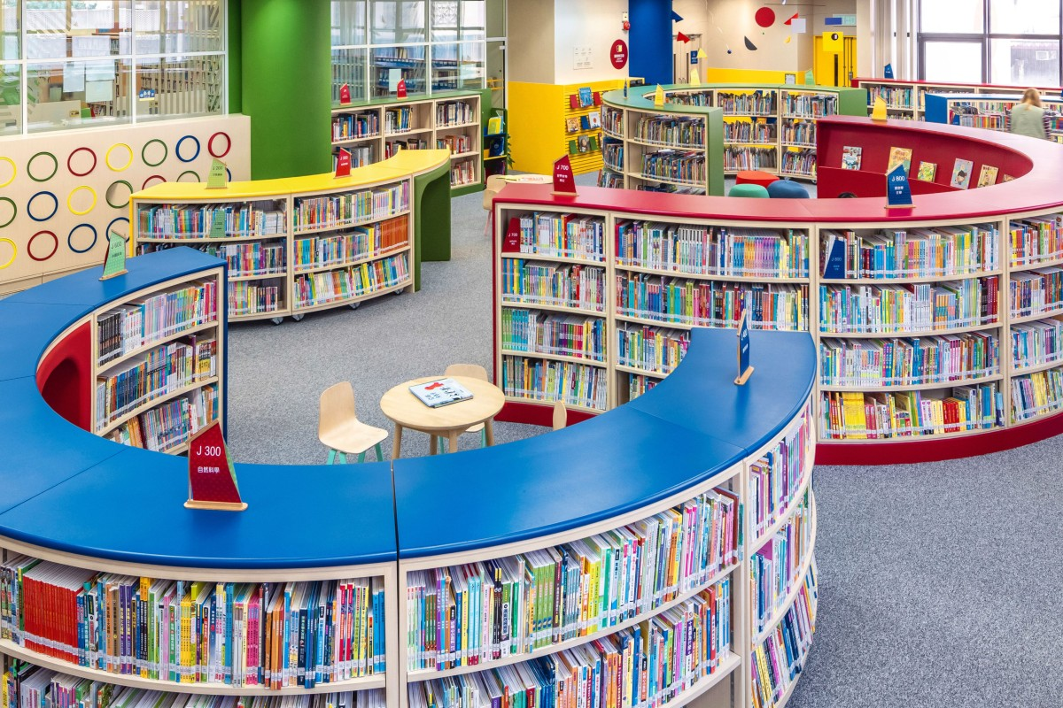

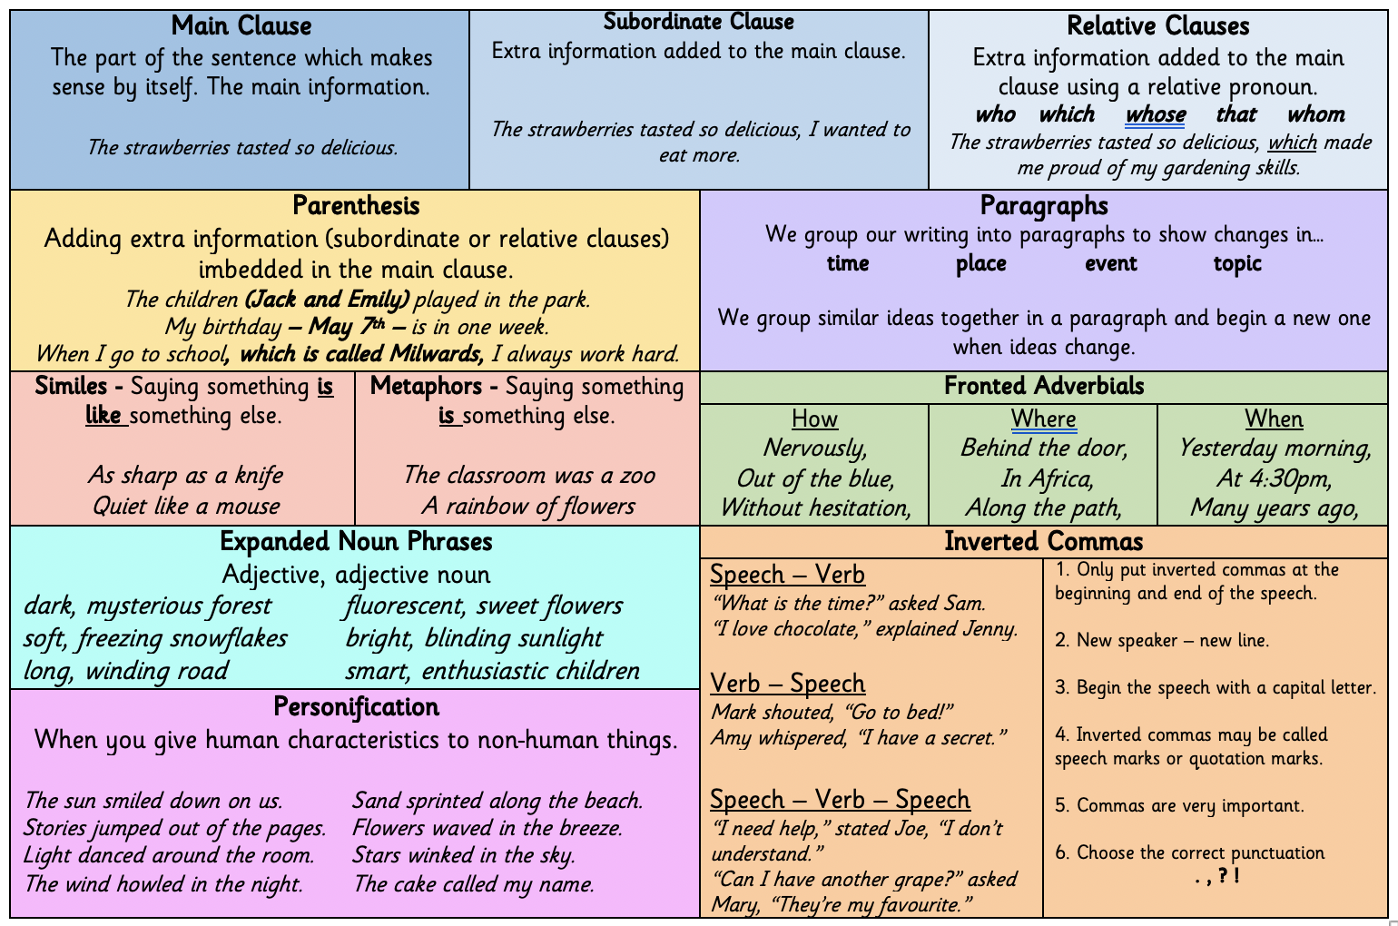
Homework
Adding these things to your routine will have a huge impact on your child’s progress.
Daily reading
Maths Arithmetic
Spelling and Grammar
Talk about school!

Slide 9
Behaviour
House team tokens
Merits: Green Slips
Star of the week
Headteacher Commendations
Classroom expectations
Reminders
Red slips and yellow slips

Slide 10
Social Media & Safeguarding
Increasingly issues involving the use of social media and messaging services are being brought to our attention, which can affect and distract from the work we do in school.
Unfortunately, inappropriate use of the internet happens from home or on pupils’ mobile devices during evenings, weekends and holidays. Although staff at Milwards are grateful to those who advise us of these issues, we have little to no jurisdiction in policing these platforms and can only take further action if there is a safeguarding issue or if illegal activity has taken place. In these instances any issues would be passed on to the appropriate authorities and agencies.
Please check our school website and newsletters for any updates or messages about safeguarding regarding Social Media.

Slide 11
Social Media and Cyber Bullying
In cases of sustained cyber-bullying involving children from Milwards these issues will be dealt with in accordance to our behaviour and bullying policy.
For example,
Creating WhatsApp groups and giving them inappropriate names or purposefully missing people out of the group.
Sending unkind messages and picture to others on WhatsApp or Snapchat then deleting the messages afterwards.
The responsibility for monitoring a child’s use of social media, or indeed the internet in general, lies with parents/carers. We strongly encourage you to discuss issues around this with your children.

Slide 12

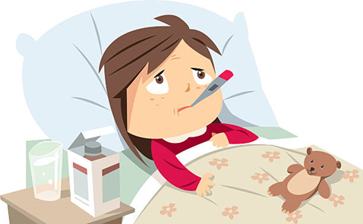
Everyone gets sick and children have a tendency to pick up bugs etc. We are here to work with you to get the best outcomes for your child.
Please talk to us, as soon as you are experiencing an issue. You can speak to the office team or class teacher.
We are keen to work with you to ensure that your child is maximising their time here at Milwards Primary School.

Slide 13
For pupils to achieve a good standard of academic and social success in school they need to attend school on a regular basis.
Something to think about...
Attendance statistics over a one year period:
98% absence = 4 days off school
95% absence = 10 days off school
90% absence = 4 weeks off school
85% absence = 5.5 weeks off school
80% absence = 7.5 weeks off school
Attendance statistics over a five year period:
85-90% absence = half a year off school
80% absence = 38 weeks off school - this is a whole year!

Slide 14


Today, the children have been sent home with:
Grammar poster
KS2 spelling lists
Everyone is equal and everyone is accepting.
We are very proud of our welcoming and inclusive school and of everyone within it. Our aim is that your child will feel happy here.
Please check Parent Hub and our social media pages for any messages or updates. They are sent out regularly.
If you have any queries or questions please contact the school office.

