Slide 1


YEAR 3
Welcome to Birch Class

Slide 2
Meet the Year Three Team
Ms Taylor (Mon – Wed) & Mrs Pinkett (Thurs – Fri)
Mrs Downes
Mrs Harris Mrs Elington

Slide 3

Year 3 Topics
Autumn: Extreme Exploring
Spring: Disasters and Destruction
Summer: World of Wonder

Slide 4
Year 3 potential trips / curriculum enrichment
Autumn
Stone Age day – in school
Whole-school pantomime
Spring
Volcanoes and Earthquakes – in school
Summer
Lea Valley – Waltham Abbey Gardens

Slide 5
Reading
All children will be assessed for reading within the first few weeks, checking both their phase and book band.
Children will be reading daily in school and will keep the same book all week. This will be changed on a Monday.
Children will have the opportunity to bring home a ‘sharing’ book. This works the same way as a library book and is chosen by the children based on their interests. This is in addition to their reading book.
Reading diaries are now being used for Key Stage 1 and Early Years only.

Slide 6

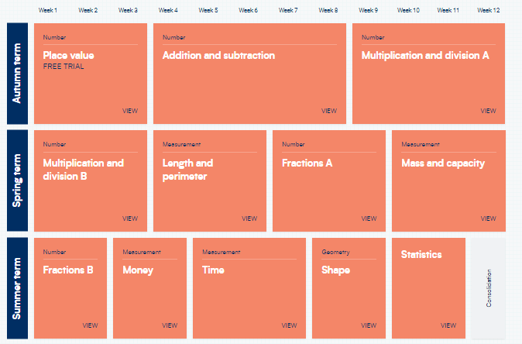
Maths Mastery
Maths Mastery is a belief that all pupils are capable of understanding and doing mathematics, given sufficient time. It keeps the class working together on the same topic, whilst at the same time addressing the need for all pupils to master the curriculum. Challenge is provided through depth rather than acceleration into new content.

Slide 7

Spelling and reading words
End of Year 4 expectation: to be able to spell most of these words.
Practising daily in school – please continue practise at home.

Slide 8
Times tables
2, 5, 10 (Year 2)
3, 4, 8 (Year 3)
Children need to be fluent by the end of the year in preparation for Multiplication Test in Year 4. Please practise.
TTRockstars – accessible via Wonde

Slide 9
What can you do at home to help?
Daily reading: Bug Club / recipes / other texts you have - enrichment
Practising Times Tables (Numbots / TTrockstars)
Phonics, Spellings & Reading words
Topic when appropriate - this could be project based and continue over a few weeks.

Slide 10
Uniform
Please make sure your child has the correct school uniform including plain black shoes (no sandals or open-toed shoes/no heels or trainers).
It is advisable to keep long hair tied back while children are at school because it can obstruct their vision and distract them when they are learning.
Please keep hair accessories to a minimum – e.g. navy blue hair bobble/scrunchie, small hair slide to keep hair out of the eyes.
Ensure that your child has a warm/waterproof winter coat for the cold weather as well as hats, gloves and scarves.
Label everything!

Slide 11

P.E.
Please ensure that your child arrives at school on their P.E. days wearing the correct P.E. kit. Your child will remain in their P.E kit throughout the day to reduce the amount of items brought into school.
Year 3 P.E. days are Tuesday and Friday
(Swimming – will be during the Summer Term)
Indoor:-
Black shorts
Plain white T-shirt/white polo shirt
Black Plimsolls/trainers
Outdoor:-
Navy jogging bottoms
Plain white T-shirt/white polo shirt
Navy sweatshirt/hoodie
trainers
No earrings are allowed to be worn during any P.E. lessons. Please send your child in without earrings on P.E. days.

Slide 12
Behaviour
House team tokens
Merits: Green Slips
Headteacher Commendations
Warnings
Red slips and yellow slips

Slide 13
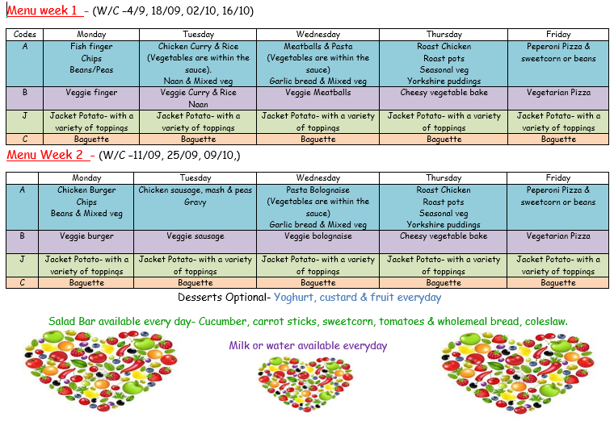
School Lunches
If you would like your child to have a school lunch, you will need to book this in advance via Scopay. You can choose which days/meals you would like.
Year 3 – send or order fruit snack.

Slide 14
Breakfast and After School Clubs
Breakfast club starts at 7:30am. Children will then be taken to their classes ready for the start of the day.
After School club runs until 5:45pm. Children will need to be collected from the main gate by this time at the latest.
If you would like to use either or both of these clubs you will need to book in advance via Scopay.

Slide 15
Social Media & Safeguarding: 2 Johns 15th Jan
Increasingly issues involving the use of social media and messaging services are being brought to our attention, which can affect and distract from the work we do in school.
Unfortunately, inappropriate use of the internet happens from home or on pupils’ mobile devices during evenings, weekends and holidays. Although staff at Milwards are grateful to those who advise us of these issues, we have little to no jurisdiction in policing these platforms and can only take further action if there is a safeguarding issue or if illegal activity has taken place. In these instances any issues would be passed on to the appropriate authorities and agencies.
Please check our school website and newsletters for any updates or messages about safeguarding regarding Social Media.

Slide 16
Social Media and Cyber Bullying
In cases of sustained cyber-bullying involving children from Milwards these issues will be dealt with in accordance to our behaviour and bullying policy.
Therefore, it should be noted that setting up groups and naming them ‘We hate _________ (insert child’s name)’ is a form of bullying, which will not be tolerated. Additionally, in many cases a child may put themselves at considerable risk due to the misuse of social media accidentally. e.g. giving personal details, publishing photographs, videos of themselves etc. to a ‘friend’ who then distributes this information more widely. As a school we educate the children about these risks, but parents and children also need to be fully aware of these risks and carefully monitor their use of social media.
The responsibility for monitoring a child’s use of social media, or indeed the internet in general, lies with parents/carers. We strongly encourage you to discuss issues around this with your children.

Slide 17
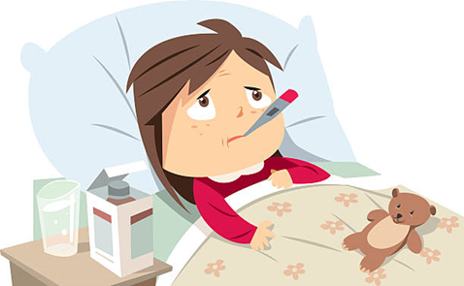

Everyone gets sick and children have a tendency to pick up bugs etc. We are here to work with you to get the best outcomes for your child.
Please talk to us, as soon as you are experiencing an issue. You can speak to the office team or class teacher.
We are keen to work with you to ensure that your child is maximising their time here at Milwards Primary School.

Slide 18
Excellent attendance at school is important to allow a child or young person to fulfil their potential. Below are just some of the key reasons why it is so important children attend school:
To learn.
To have fun.
To make new friends. Miss School - Miss Out!!
To experience new opportunities, experiences and adventures in life.
To develop awareness of other cultures, religion, ethnicity and gender differences.
To achieve and make progress.
To gain qualifications.
To develop new skills.
To build confidence and self-esteem.
To have the best possible start in life.

Slide 19
For pupils to achieve a good standard of academic and social success in school they need to attend school on a regular basis.
Something to think about...
Attendance statistics over a one year period:
98% absence = 4 days off school
95% absence = 10 days off school
90% absence = 4 weeks off school
85% absence = 5.5 weeks off school
80% absence = 7.5 weeks off school
Attendance statistics over a five year period:
85-90% absence = half a year off school
80% absence = 38 weeks off school - this is a whole year!

Slide 20
HOW PARENTS CAN HELP –
Establish a good routine in the mornings and evenings so your child is prepared for the school day ahead.
Make sure your child goes to school regularly and follows the school rules.
Ensure your child arrives at school on time – not late.
Arrange dental and medical appointments outside school hours.
Always inform the school if your child is absent due to illness.
Take truancy seriously – if your child is not attending school as you expect they may be putting themselves at risk – Who are they with? What are they doing?
Take family holidays outside term time.
Talk to your child about school and take an interest in their school work (including homework).
Attend parent consultations, open afternoons and school events.
Praise and reward your child’s achievements at school (academic and social).
Always support school staff in their efforts to work with challenging behaviour.
Discuss any concerns or difficulties with the school – staff are there to help and will be supportive.

Slide 21

Everyone is equal and everyone is accepting.
We are very proud of our welcoming and inclusive school and of everyone within it. Our aim is that your child will feel happy here.
Please check Parent Hub and the school website for any messages or updates. They are sent out regularly.
If you have any queries or questions please contact the school office.

