Slide 1

Welcome to Maple Class
2024-2025

Slide 2

The Team!
Miss Alcock – Class Teacher
Mrs Watson - LSA

Slide 3
Year 2 Topics
History Focus – The Great Fire of London
Geography Focus – Journey to Another Place
Science Focus – Our Beautiful World

Slide 4
School Trips
Autumn Term – Pantomime/Potential GFoL Visit
Spring Term – Aquarium/the beach
Summer Term – Local visit - TBC

Slide 5
uNIFORM
Please make sure your child has the correct school uniform including plain black shoes (no sandals or open-toed shoes/no heels or trainers).
It is advisable to keep long hair tied back while children are at school because it can obstruct their vision and distract them when they are learning.
Please keep hair accessories to a minimum – e.g. navy blue hair bobble/scrunchie, small hair slide to keep hair out of the eyes.
Ensure that your child has a warm/waterproof winter coat for the cold weather as well as hats, gloves and scarves. Label everything!

Slide 6
P.E.
Please ensure that your child arrives at school on their P.E. days wearing the correct P.E. kit (this is still uniform). Your child will remain in their P.E kit throughout the day to reduce the amount of items brought into school.
Year 2’s P.E. days are Mondays (outdoor) and Wednesdays (indoor).

Slide 7
Expectations for pe kits
Indoor:-
Black/navy shorts
Plain white T-shirt/white polo shirt
Black plimsolls/trainers
Outdoor:-
Navy jogging bottoms
Plain white T-shirt/white polo shirt
Navy sweatshirt/hoodie
trainers
No earrings are allowed to be worn during any P.E. lessons.
Please make sure long hair is tied up for safety.

Slide 8
Year 2 Expectations and Priorities
SATs are no longer statutory in KS1 and as a school, we choose not to participate in these.
Every child is unique and learns at their own pace, but below are some key learning goals we hope the children reach by the end of KS1.
Children can decode fluently when reading.
Children can spell the first 100 high frequency words.
Children can read and write numbers accurately.
Children can form letters correctly and spell their name.
Children can write in sentences with a full stop and capital letter.
Children know their 2, 5, 10 and 3 times tables.
Children know and use number bonds.
Children have the correct pencil grip.
Children can focus for longer periods of time.
Children have increased independence.

Slide 9
What will my child do in English in year 2?
Your child will continue to build their confidence and fluency in reading and writing. By the end of the year, they should be able to write using full sentences and decode their reading books with ease.
Phonics remains a big focus in Year 2. Your child will have phonics lessons every day, recapping their learning from Year 1 and applying this to writing. If they did not pass their phonics test in Year 1, they will retake this year.
Children in Year 2 should begin to join their handwriting, providing their letter formation is accurate at this stage. If it is not, this will be a focus before allowing children to learn to join.
Children should be applying their phonetical awareness in their writing now, but should do this with increased accuracy in Year 2, considering alternative sounds. They should also be spelling the first 200 high frequency words accurately.

Slide 10
What to Expect in Year 2 Maths
Children will continue to build on the key skills that form the foundations of their maths learning. Some of the number national curriculum objectives for Year 2 include comparing and ordering numbers from 0 to 100 and recognising the place value of 2-digit numbers.
Times tables practice is vital to help your child succeed in other areas of maths. In Year 2, your child should be able to fluently recall their 2, 3, 5 and 10 times tables.
It is also important that children are able to tell the time using o’clock and half past, working towards quarter to and past, as well as becoming familiar with money. They should also be able to recognise 2D and 3D shapes.

Slide 11

Reading
At Milwards, we encourage the children to read as often as possible. In Year 2 we read to the children daily, we listen to the children daily and give the children daily opportunities to read independently. Children really enjoy this and benefit greatly from the routine of reading. It is important that you listen to and read to your child as often as possible, it has such a positive effect.
Reading for pleasure is the most important thing, so focus on reading things your child wants to read at home. Please speak to us if you need advice of books to keep at home, as well as how to source books.

Slide 12
Reading at school
All children will have two reading books.
One is a school book, which is kept at school at all times. This is so the children can be heard reading at any time.
The other is a home book. This matches their reading level and is an optional book to read at home with your children.
Both books are changed on a Monday. This is due to the importance of fluency and oracy practice, as opposed to getting through as many books as possible.

Slide 13
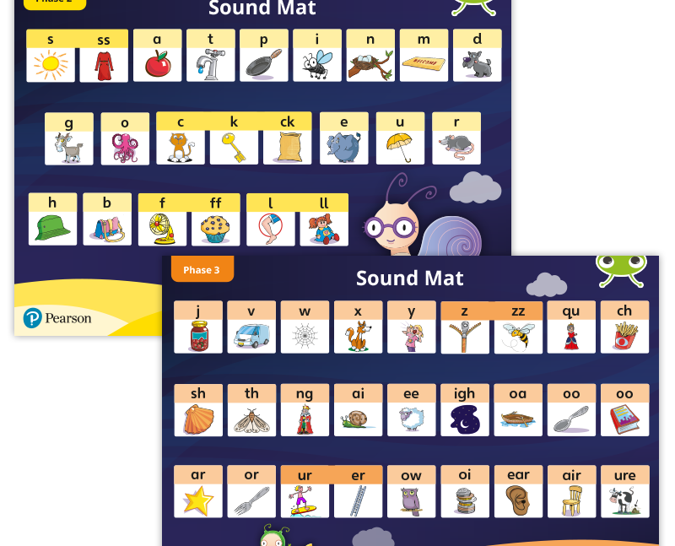
Phonics
We use Bug Club Phonics and Bug Club Reading. Your child will come home with a copy of the sound and picture associations we use soon.

Slide 14
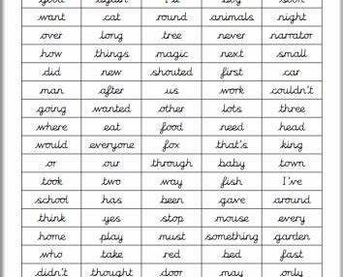
Spelling
Practise reading and spelling the first 200 high frequency words. These will not be weekly or tested in this way, as this is not effective for long-term memory. Instead, we will keep a log of spellings in children’s English books, encouraging them to use this and apply them.

Slide 15


English schemes
Throughout school we use Power of Reading to deliver the English curriculum.
The Power of Reading is about teaching English by using high quality books, literature and creative and engaging teaching approaches. This can include art, drama and creative writing.
This method of teaching aims to stimulate, engage, motivate and challenge children in their learning. It ensures we have high expectations of every child.
Using high quality texts exposes the children to higher level vocabulary which they will then be able to use in their own writing.

Slide 16

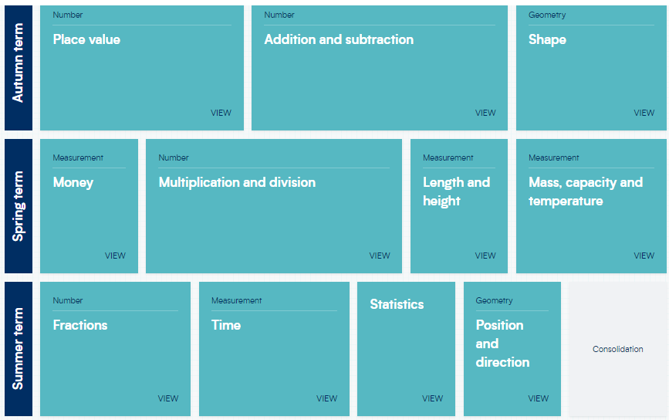
Maths MASTERY

Slide 17

Behaviour
House team tokens
Merits: Green Slips
Headteacher Commendations
Warnings
Red slips and yellow slips
Star of the week
You All Belong Here system

Slide 18
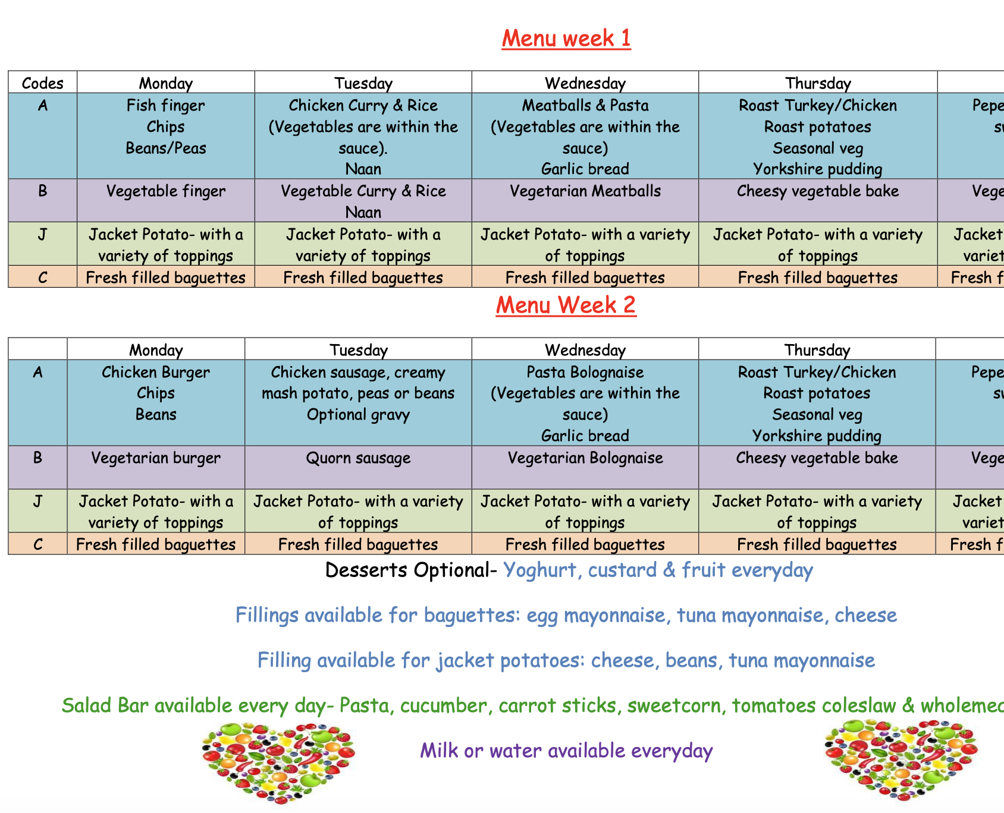
School Lunches
If you would like your child to have a school lunch, you will need to book this in advance via Scopay. You can choose which days/meals you would like.

Slide 19
Breakfast and after school clubs
Breakfast club starts at 7:30am. Children will then be taken to their classes ready for the start of the day.
After School club runs until 5:45pm. Children will need to be collected from the main gate by this time at the latest.
If you would like to use either or both of these clubs you will need to book in advance via Scopay.

Slide 20

Social media and safeguarding

Slide 21
Increasingly issues involving the use of social media and messaging services are being brought to our attention, which can affect and distract from the work we do in school.
Unfortunately, inappropriate use of the internet happens from home or on pupils’ mobile devices during evenings, weekends and holidays. Although staff at Milwards are grateful to those who advise us of these issues, we have little to no jurisdiction in policing these platforms and can only take further action if there is a safeguarding issue or if illegal activity has taken place. In these instances any issues would be passed on to the appropriate authorities and agencies.
Please check our school website and newsletters for any updates or messages about safeguarding regarding Social Media.

Slide 22
More APPLICABLE FOR KS1…
Additionally, in many cases a child may put themselves at considerable risk due to the misuse of social media accidentally. e.g. giving personal details, publishing photographs, videos of themselves etc. to a ‘friend’ who then distributes this information more widely. As a school we educate the children about these risks, but parents and children also need to be fully aware of these risks and carefully monitor their use of social media.
The responsibility for monitoring a child’s use of social media, or indeed the internet in general, lies with parents/carers. We strongly encourage you to discuss issues around this with your children.
Please ensure you attend the Two Johns talk later in the year – information will be sent on Parent Hub.

Slide 23
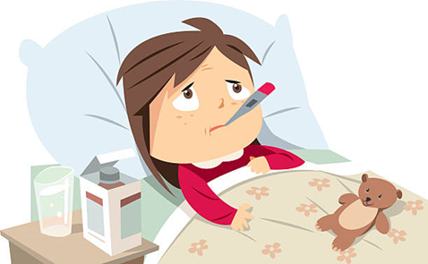
aTTENDANCE
Everyone gets sick and children have a tendency to pick up bugs etc. We are here to work with you to get the best outcomes for your child.
Please talk to us, as soon as you are experiencing an issue. You can speak to the office team or class teacher.
We are keen to work with you to ensure that your child is maximising their time here at Milwards Primary School.

Slide 24
Excellent attendance at school is important to allow a child or young person to fulfil their potential. Below are just some of the key reasons why it is so important children attend school:
To learn.
To have fun.
To make new friends. Miss School - Miss Out!!
To experience new opportunities, experiences and adventures in life.
To develop awareness of other cultures, religion, ethnicity and gender differences.
To achieve and make progress.
To gain qualifications.
To develop new skills.
To build confidence and self-esteem.
To have the best possible start in life.

Slide 25
For pupils to achieve a good standard of academic and social success in school they need to attend school on a regular basis.
Something to think about...
Attendance statistics over a one year period:
98% absence = 4 days off school
95% absence = 10 days off school
90% absence = 4 weeks off school
85% absence = 5.5 weeks off school
80% absence = 7.5 weeks off school
Attendance statistics over a five year period:
85-90% absence = half a year off school
80% absence = 38 weeks off school - this is a whole year!

Slide 26
How parents can help
Establish a good routine in the mornings and evenings so your child is prepared for the school day ahead.
Make sure your child goes to school regularly and follows the school rules.
Ensure your child arrives at school on time – not late.
Arrange dental and medical appointments outside school hours where possible.
Always inform the school if your child is absent due to illness.
Take family holidays outside term time.
Talk to your child about school and take an interest in their school work (including homework).
Attend parent consultations, open afternoons and school events.
Praise and reward your child’s achievements at school (academic and social).
Always support school staff in their efforts to work with challenging behaviour.
Discuss any concerns or difficulties with the school – staff are there to help and will be supportive.

Slide 27

Thank you for your time
Everyone is equal and everyone is accepting.
We are very proud of our welcoming and inclusive school and of everyone within it. Our aim is that your child will feel happy here.
Please check Parent Hub and the school website for any messages or updates. They are sent out regularly.
If you have any queries or questions please contact the school office.

